Slide 1

About us
FAQ
Contact
User Login
with fingerprint
Username
Submit
©Mosip.io

Slide 2
About us
FAQ
Contact
User Login
with Iris
Username
Submit
©Mosip.io

Slide 3
About us
FAQ
Contact
User Login
with Face
Username
Submit
©Mosip.io

Slide 4
About us
FAQ
Contact
User Login
Username
Password
Reset Password
Submit
©Mosip.io

Slide 5
About us
FAQ
Contact
User Login
Username
Enter OTP
Get OTP
Submit
Valid for 2minutes
©Mosip.io

Slide 6
About us
FAQ
Contact
User Login
Username
Enter OTP
Resend OTP
Submit
©Mosip.io

Slide 7





Internal Verifier Name :
Internal Verifier Name
#9844JF9
Internal Verifier ID :
Internal Verifier Office :
Headquarter
/ Internal Verification
Registration Details
UIN Generated
Full Name :
Date of Birth :
Gender :
Address Line 1 :
City :
Province :
Postal Code :
Mobile :
Email :
Applicant Name
26-10-1991
Male
Sit dolor amet
Xyzz
Xyz
737003
8888220020
Email@id.com
Full Name :
Date of Birth :
Gender :
Address Line 1 :
City :
Province :
Postal Code :
Mobile :
Email :
Applicant Name
26-10-1991
Male
Sit dolor amet
Xyzz
Xyz
737003
8888220020
Email@id.com
POA
POI
POB
Approve
Reject

Slide 8
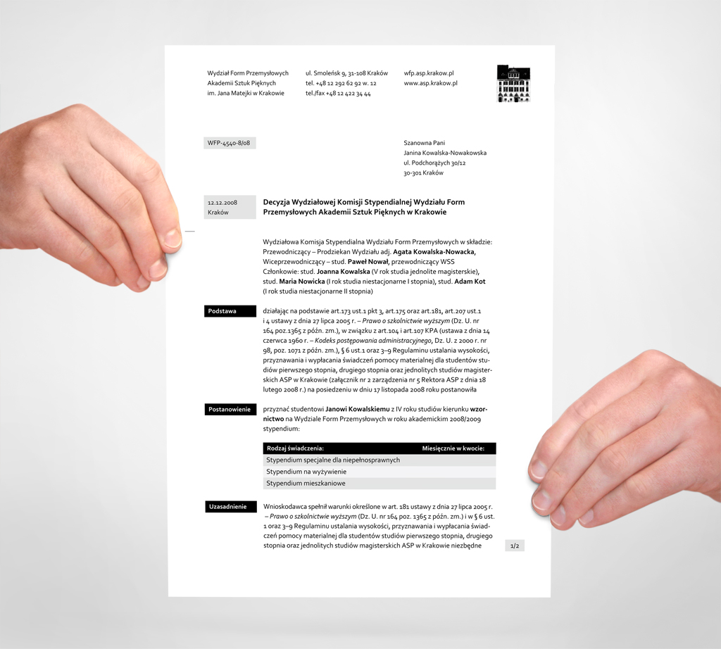
Internal Verifier Name :
Internal Verifier Name
#9844JF9
Internal Verifier ID :
Internal Verifier Office :
Headquarter
Passport
Passport
/ Internal Verification List / Registration Details
X
X
Registration Details
Exception :
Full Name :
Date of Birth :
Gender :
Address Line 1 :
City :
Province :
Postal Code :
Mobile :
Email :
POA :
POR :
View Image
Applicant Name
26-10-1991
Male
Sit dolor amet
Xyzz
Xyz
737003
8888220020
Email@id.com
Pan card
Passport
Documents :
Full Name :
Date of Birth :
Gender :
Address Line 1 :
City :
Province :
Postal Code :
Mobile :
Email :
POA :
POR :
View Image
Applicant Name
26-10-1991
Male
Sit dolor amet
Xyzz
Xyz
737003
8888220020
Email@id.com
Pan card
Passport
Approve
Reject

Slide 9
Internal Verifier Name :
Internal Verifier Name
#9844JF9
Internal Verifier ID :
Internal Verifier Office :
Headquarter
Applicant Name
Applicant Name
/ Internal Verification List / Registration Details
X
X
Registration Details
2
2
2
2
2
2
2
2
2
2
2
2
z
z
2
2
z
2
z
Left Hand Palm
Right Hand Palm
Left Hand Palm
Right Hand Palm
Quality % : 85%
Quality % : 85%
Quality % : 85%
Quality % : 85%
Exception :
Full Name :
Date of Birth :
Gender :
Address Line 1 :
City :
Province :
Postal Code :
Mobile :
Email :
POA :
POR :
View Image
Applicant Name
26-10-1991
Male
Sit dolor amet
Xyzz
Xyz
737003
8888220020
Email@id.com
Pan card
Passport
Documents :
Full Name :
Date of Birth :
Gender :
Address Line 1 :
City :
Province :
Postal Code :
Mobile :
Email :
POA :
POR :
View Image
Applicant Name
26-10-1991
Male
Sit dolor amet
Xyzz
Xyz
737003
8888220020
Email@id.com
Pan card
Passport
2
2
2
2
z
z
z
z
Both Thumbs
Both Thumbs
Quality % : 85%
Quality % : 85%
Approve
Reject

Slide 10
Internal Verifier Name :
Internal Verifier Name
#9844JF9
Internal Verifier ID :
Internal Verifier Office :
Headquarter
Applicant Name
Applicant Name
/ Internal Verification List / Registration Details
X
X
Registration Details
Left Eye
Left Eye
Left Eye
Quality % : 85%
Quality % : 85%
Exception :
Full Name :
Date of Birth :
Gender :
Address Line 1 :
City :
Province :
Postal Code :
Mobile :
Email :
POA :
POR :
View Image
Applicant Name
26-10-1991
Male
Sit dolor amet
Xyzz
Xyz
737003
8888220020
Email@id.com
Pan card
Passport
Documents :
Full Name :
Date of Birth :
Gender :
Address Line 1 :
City :
Province :
Postal Code :
Mobile :
Email :
POA :
POR :
View Image
Applicant Name
26-10-1991
Male
Sit dolor amet
Xyzz
Xyz
737003
8888220020
Email@id.com
Pan card
Passport
Exception
Right Eye
Right Eye
Quality % : 85%
Approve
Reject

Slide 11

Internal Verifier Name :
Internal Verifier Name
#9844JF9
Internal Verifier ID :
Internal Verifier Office :
Headquarter
Applicant Name
Applicant Name
/ Internal Verification List / Registration Details
X
X
Registration Details
No exception image available.
Exception :
Full Name :
Date of Birth :
Gender :
Address Line 1 :
City :
Province :
Postal Code :
Mobile :
Email :
POA :
POR :
View Image
Applicant Name
26-10-1991
Male
Sit dolor amet
Xyzz
Xyz
737003
8888220020
Email@id.com
Pan card
Passport
Documents :
Full Name :
Date of Birth :
Gender :
Address Line 1 :
City :
Province :
Postal Code :
Mobile :
Email :
POA :
POR :
View Image
Applicant Name
26-10-1991
Male
Sit dolor amet
Xyzz
Xyz
737003
8888220020
Email@id.com
Pan card
Passport
Approve
Reject

Slide 12
Internal Verifier Name :
Internal Verifier Name
#9844JF9
Internal Verifier ID :
Internal Verifier Office :
Headquarter
/ Internal Verification List / Registration Details
Registration Details
Reason for Rejection
Correction not possible
Exception :
Full Name :
Date of Birth :
Gender :
Address Line 1 :
City :
Province :
Postal Code :
Mobile :
Email :
POA :
POR :
View Image
Applicant Name
26-10-1991
Male
Sit dolor amet
Xyzz
Xyz
737003
8888220020
Email@id.com
Pan card
Passport
Documents :
Full Name :
Date of Birth :
Gender :
Address Line 1 :
City :
Province :
Postal Code :
Mobile :
Email :
POA :
POR :
View Image
Applicant Name
26-10-1991
Male
Sit dolor amet
Xyzz
Xyz
737003
8888220020
Email@id.com
Pan card
Passport
Submit
Approve
Reject

